Slide 1
KP Parts Test Report 2020

Slide 2
Testing of:
Stainless Steel Parts 2&3.
Santoprene Fuel Hose.
Limit switch bracket with slots.
KP hood rubber grommets.

Slide 3
Objectives

Slide 4
Objective 1: Stainless Steel Parts 2&3
The purpose of the test is to assess the performance of the Stainless Steel Smart valve on a KP with actual dispenses for mass production decision making.
This test observes the following parameters;
Accuracy of dispenses done
Flow rate achieved during the measured dispenses
Status of the dock during after a dispense
Level of fuel in the air return line after a dispense

Slide 5
Objective 2: Santoprene Fuel Hose
The purpose of the test is to assess the performance of the santoprene fuel hose on KP751 and in a lab setup for mass procurement decision making.
This test observes the following parameters;
Loss of ethanol through the hoses that affects dispense accuracy.
Reaction with ethanol.
Fitment and ease of removal from KP components.

Slide 6
Objective 3: Limit Switch Bracket With Slots
The purpose of the test is to assess the performance of the limit switch bracket on a KP with actual dispenses for mass production decision making.
This test observes the following parameter;
The endurance and accuracy of using a slot to mount the limit switch on it’s bracket during accelerated KP dispenses.

Slide 7
Objective 4: KP Hood Rubber Grommets.
The purpose of the test is to assess the performance of the hood rubber grommets on a KP for mass production decision making.
This test observes the following parameter;
Effectiveness of using a custom made rubber grommet to seal off the KP from rodents, dust and other pests.

Slide 8
Performance Test Setup

Slide 9
1. Stainless Steel Test Setup
Three calibrated KOKOPoints
-KP-0751 - Fitted with Santoprene hose and Valve no.10 (part 1 no.10)
-KP-0775 - Fitted with PU hose and Valve no.9 (part 1 no.5)
-KP-030- Fitted with PU hose and Valve set4
KP030 was left for live customers testing.
20 canisters used on KP 0751 & 0775.
1,500 dispenses (3000L) done on KP 0751 & 0775.
101 dispenses (of 2L each) per KOKOPoint per day.
Every 21st, 22nd, 41st, 42nd, 61st, 62nd, 81st, 82nd, 100th and 101st dispenses were measured and flow rate obtained.
KP 751 had a below left PCB of 12V while KP 775 had the normal 5V below left PCB
Time period
Start: 13th February 2020
End: 5th March 2020

Slide 10
2. Santoprene Test Setup
Santoprene was installed in KP 0751 for normal dispense tests.
Santoprene hoses were also setup in the lab:
A length of hose dipped in ethanol beaker to test reaction.
A length of hose filled with ethanol to test permeability.

Slide 11
3. Limit Switch Bracket Test Setup
The limit switch brackets with slots were assembled in KP 030, 0751 and 0775 for the entire duration of testing between 13th January to 5th March.
Brand new switches without deformed actuation arms were used for this test.
These tests were done simultaneously with the tests on the stainless steel smart valves as a complete subassemblies.

Slide 12
4. KP Hood Rubber Grommets Test Setup
KP hood rubber grommets were tested on:
KP at Nevillos Butchery- Local rubber bellow TOYOTA INNER PRADO used.
KP030 at KOKOplex reception- Local rubber bellow OUTER X-TRAIL used.
KP at Memos Supermarket- First sample produced in India was used.
The test criteria were:
Ease of installation on a Kp that is already out in the field with a grommet split down it’s height. These were shops that had no space width and height wise.
Effectiveness of the grommet installed in a rodent infested KP after a month of installation.
Ease of hood removal and reassembly during maintenance and routine checks.

Slide 13
Results
&
Observations

Slide 14
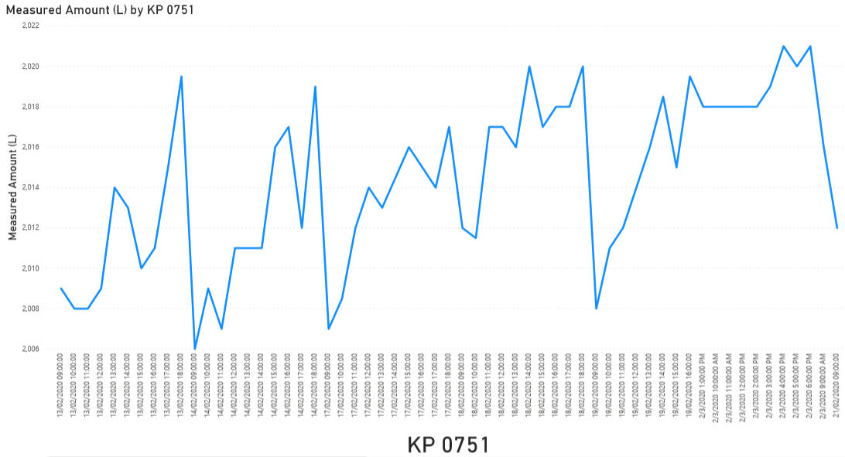
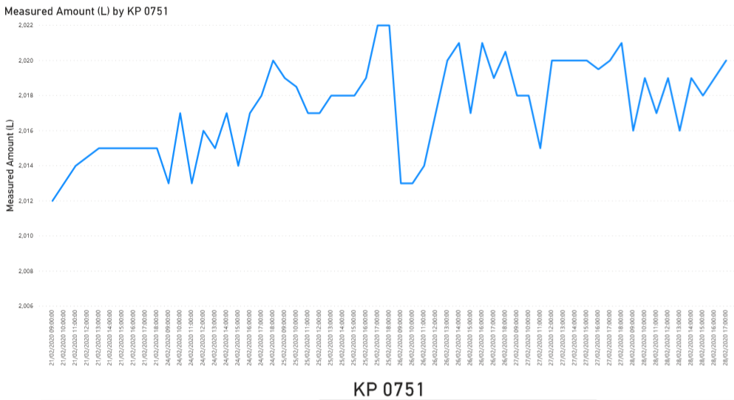
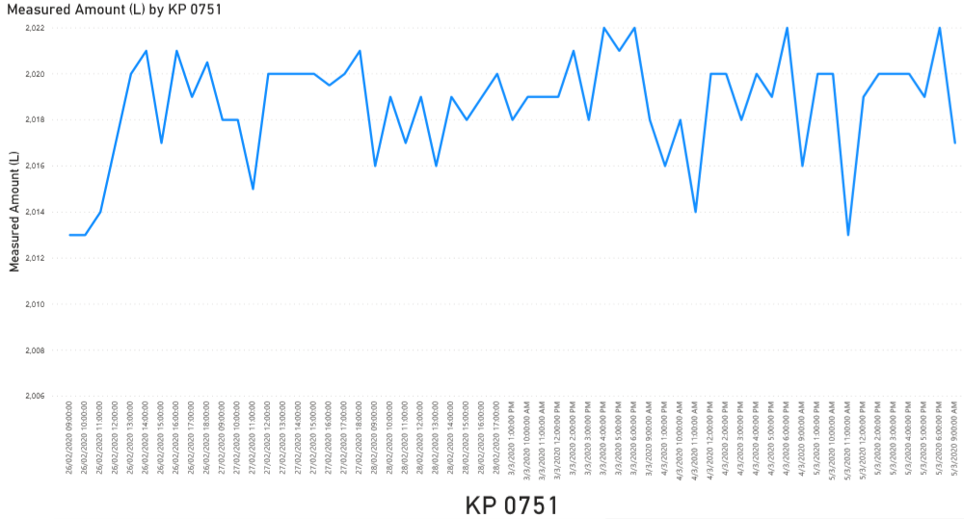
1. Stainless Steel Parts 2&3 Test Results & Observations
KP 0751: 1500 * 2 Liter Accuracy Dispenses
+/- 20ml accuracy
+/- 20ml accuracy
+/- 20ml accuracy
Number of under dispenses from total | 0
Number of over dispenses from total | 14
Percentage of over dispenses out of 1500 | 9.52%
KP0751 Generally over dispensed as it had a 12V below left PCB as opposed to the usual 5V KPs have.

Slide 15
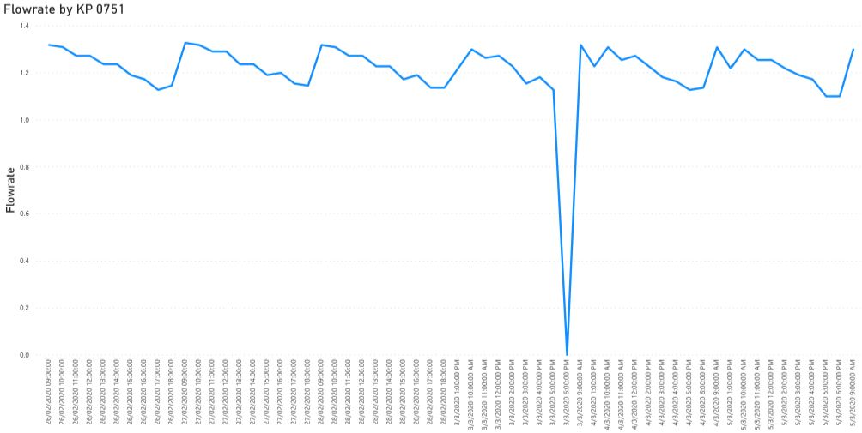
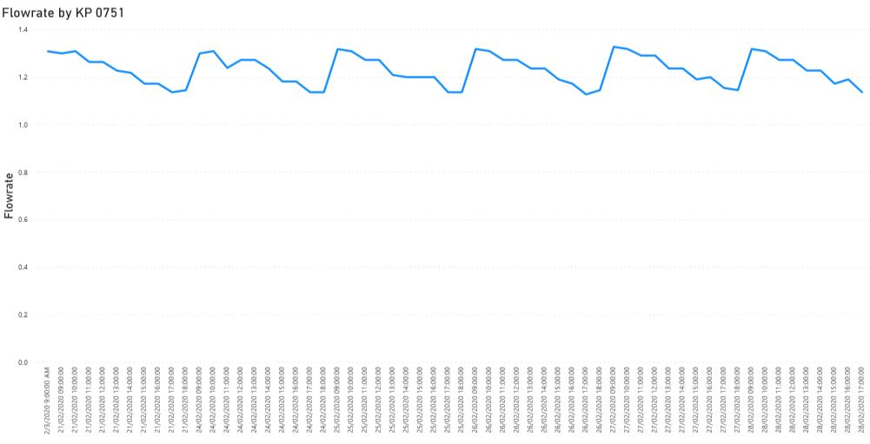
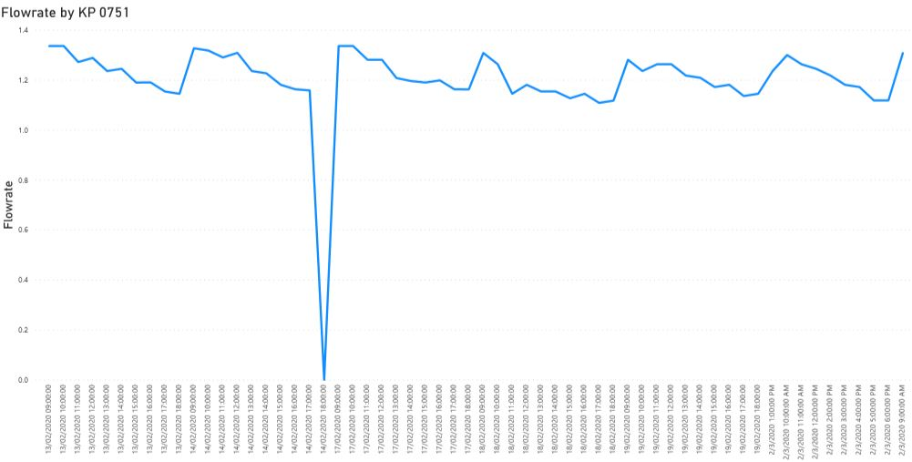
1. Stainless Steel Parts 2&3 Test Results & Observations
KP 0751: 1500 * 2 Liter Dispense Flow Rate
Average Flow Rate
Average Flow Rate
Average Flowrate | 1.21 liters per minute
Average Flow Rate
An average flow rate of 1.21L/min was low as KPs are calibrated at 1.3L/min for a QC pass. This was attributed to a faulty pump that analyzed and changed for a second round of tests.

Slide 16
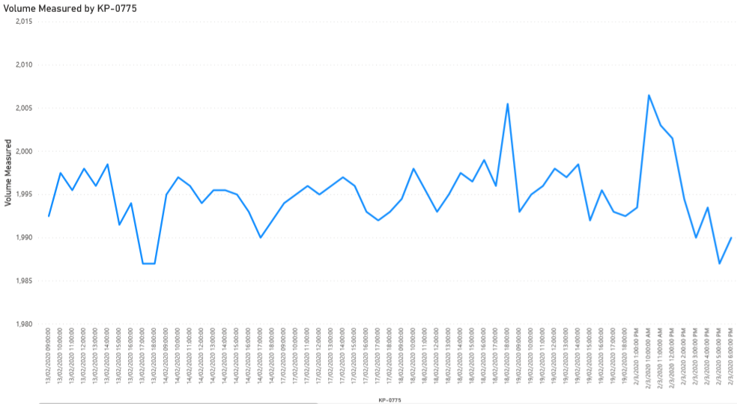
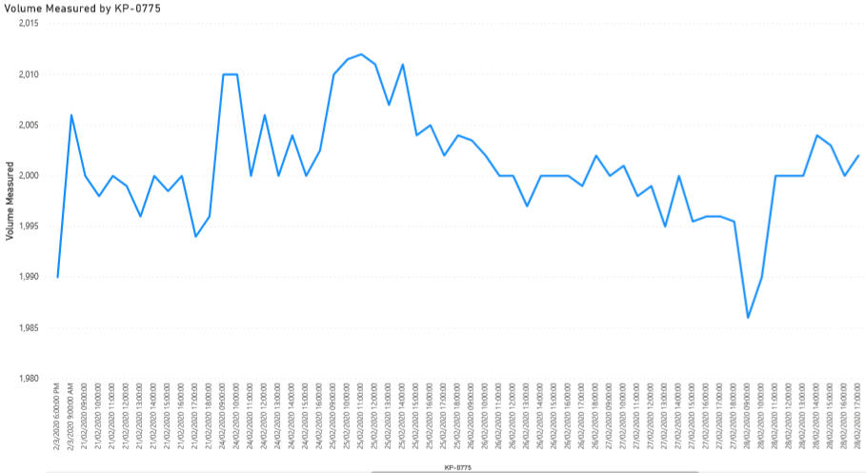
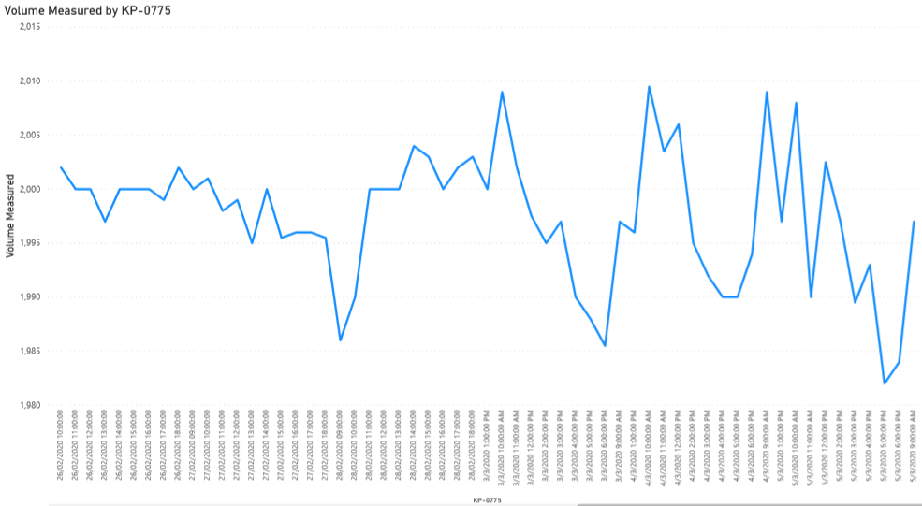
1. Stainless Steel Parts 2&3 Test Results & Observations
KP 0775: 1500 * 2 Liter Accuracy Dispenses
+/- 20ml accuracy
+/- 20ml accuracy
Number of under dispenses from total | 0
Number of over dispenses from total | 0
+/- 20ml accuracy
KP0775 had the normal 5V below left PCB but performed well as the number of under dispenses indicated were due to missing data during the filling of the physical forms.

Slide 17
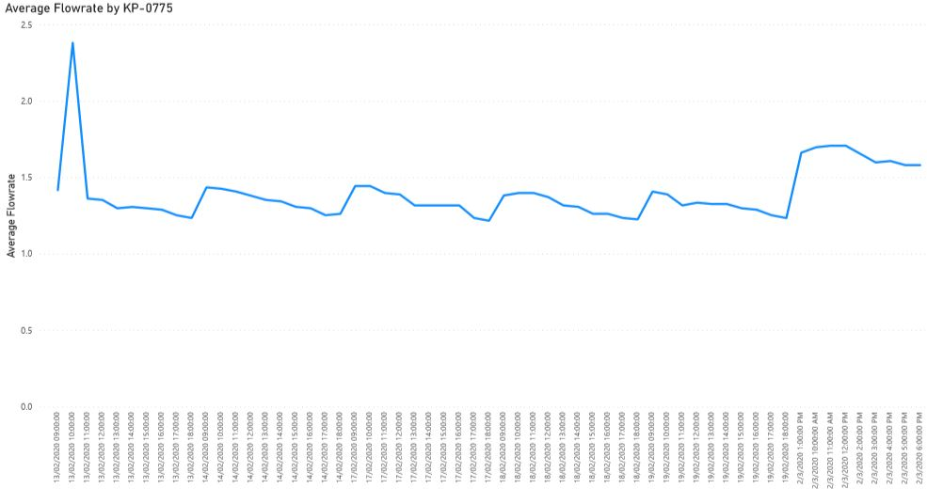
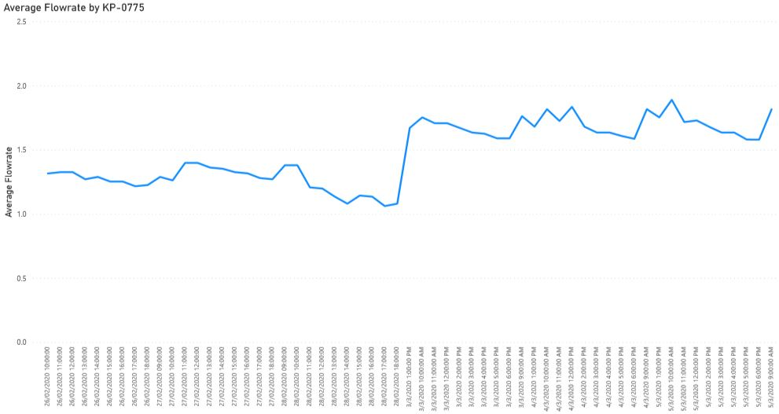
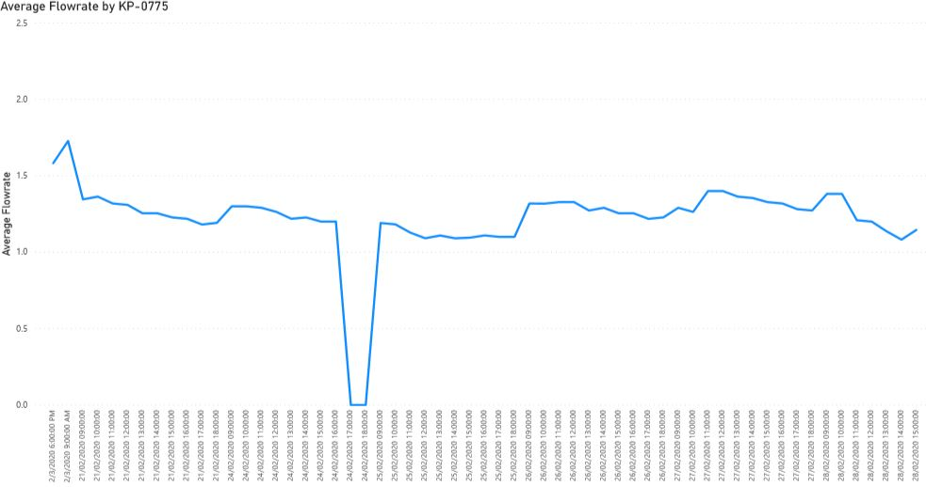
1. Stainless Steel Parts 2&3 Test Results & Observations
KP 0775: 1500 * 2 Liter Dispense Flow Rate
Average Flow Rate
Average Flow Rate
Average Flowrate | 1.38 liters per minute
Average Flow Rate
An average flow rate of 1.38L/min was acceptable as KPs are calibrated at 1.3L/min for a QC pass.

Slide 18
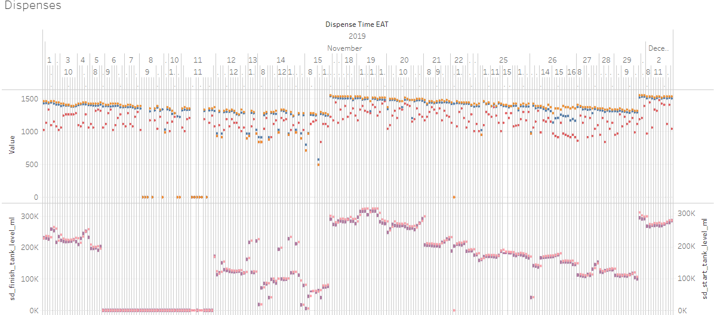
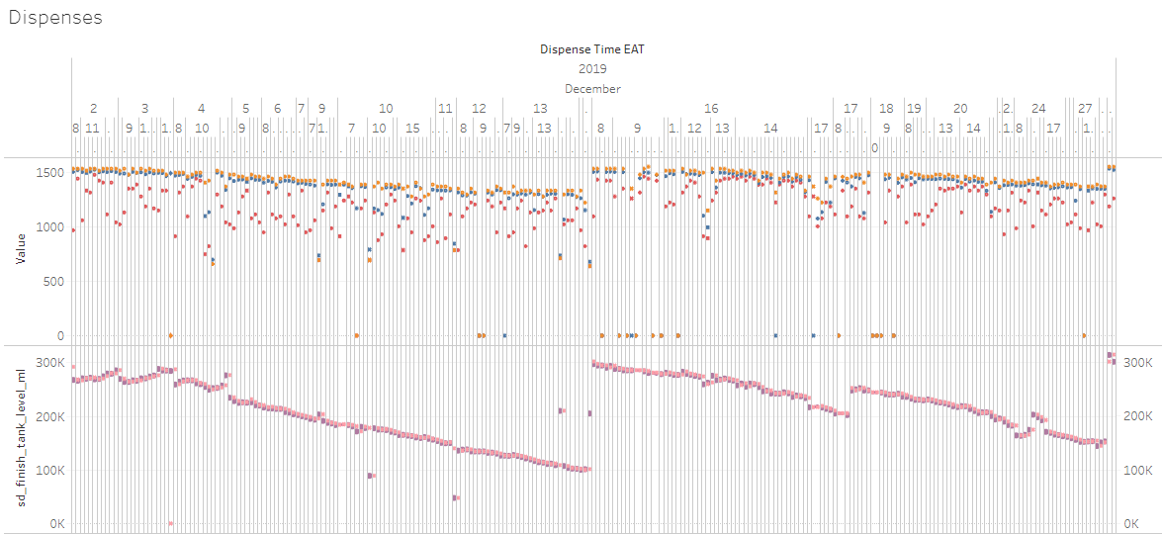
1. Stainless Steel Parts 2&3 Test Results & Observations
KP030
The average dispense rates during the months of November and December are seen to be erratic and scattered when analyzing the distribution using Tableau. This scatter presents a problem when certain dips closer to the upper and lower dispense limits of 2L/m and 0.8L/m respectively resulting in error 092.This was the only live KP we tested the SS parts on.
The maintenance team were able to provide raw data to compare KP uptime before and after installation of the SS smart valve parts.

Slide 19
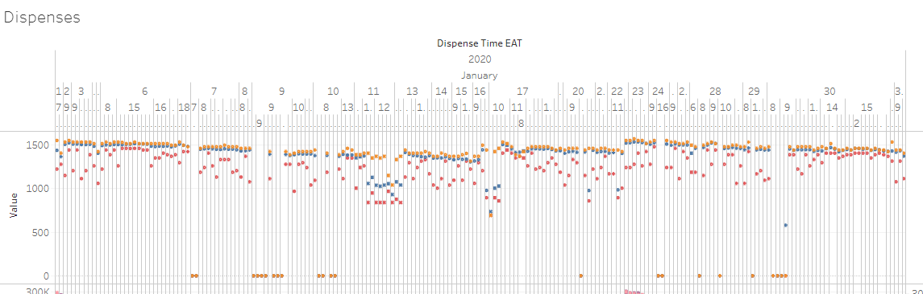
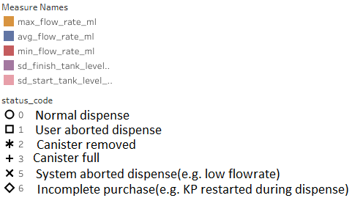
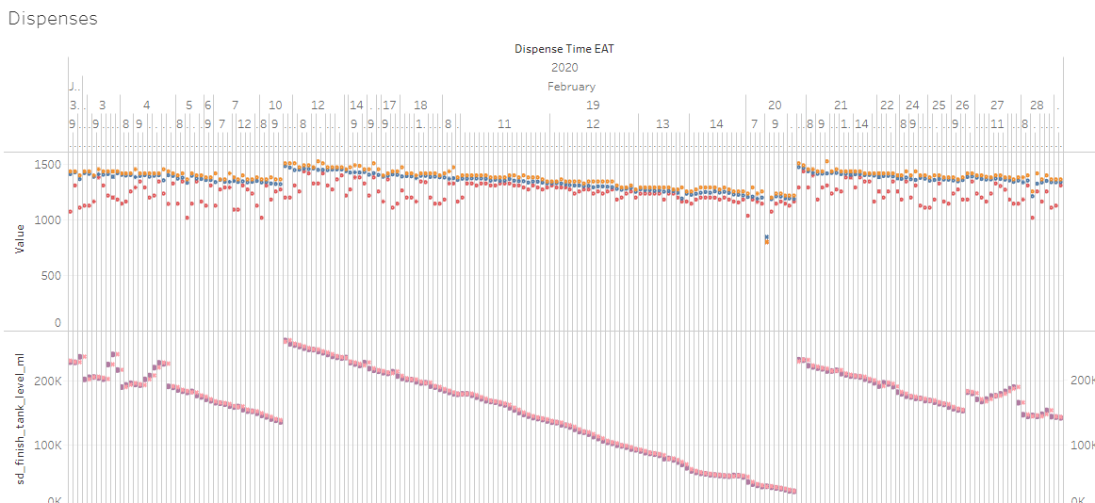
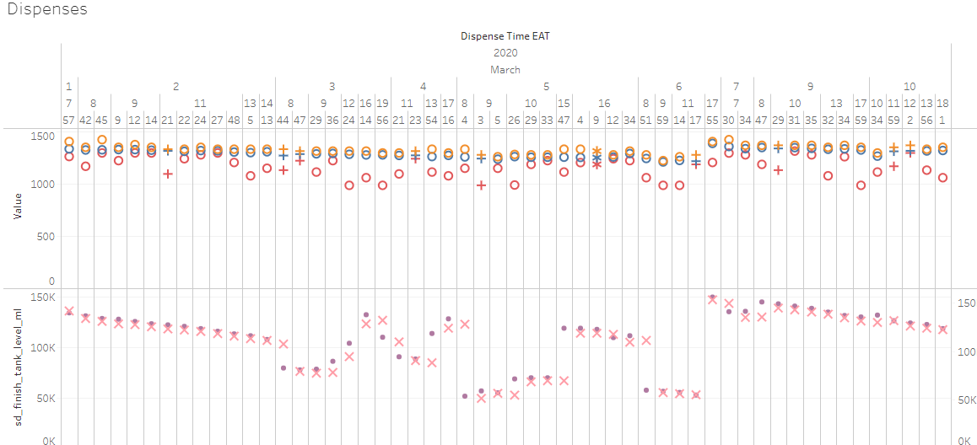
1. Stainless Steel Parts 2&3 Test Results & Observations
KP030
Prior to the installation of the SS set1 in the dock, the erratic dispense patterns are clearly seen before 17th January. The SS parts then developed issues as it was lathe milled so had to be switched out with set4 on 29th January.
Legend
SS set1 Installation date
SS set4 Installation date
The dispenses in February show a more linear dispense rate as well at a 1.4L/m. The flow rate dropped as tank levels dropped but came nowhere near the lower limit of 0.8L/m.
The first dispenses of march show a stabilized average dispense rate of 1.4L/m. This
The linearity of the flow rate after the installation of the SS parts in the smart valve means a lesser probability of error 092 in KP030. The issues that occured after this SS installation were related to faulty new canisters and a pressurized tank that was quickly resolved by technicians.

Slide 20
2. Santoprene KP Test + Lab Test Results & Observations
KP Tests
The santoprene tube was flexible enough to not kink when assembled in the KP.
The accuracy of the dispenses were within the specified range.
The santoprene tubes were easy to fit and remove from the dispense column, pump, flowmeter, dispense valve and finally to the dock.
There was no leakage at the point of connection to the components during the entire period of testing.
Lab Tests
There was no reaction observed between the santoprene tubes and ethanol as seen in Lab Test 2 results.
There was minimal loss of ethanol i.e. 3g=3ml after a period of 56 days as seen in Lab Test 1 results.
Based on the Weights and Measures dispense allowable limits for 300, 500, 1000 and 2000 ml being ±8 , ±10, ±20 and ±20 respectively, the 3ml still falls within the range.
The rapid increase in loss in the last week of measurements was attributed to human error as the ethanol was poured from the tube for measurement instead of the usual weighing of the entire setup. This loss of ethanol through evaporation and spillage explains the 1.3 gram loss.

Slide 21
2. Santoprene KP Tests + Lab Tests Results & Observations
Lab Test 1
Lab Test 2
Santoprene Tube Filled With Ethanol
Week | Weight g (Tube+Ethanol) | Ethanol Weight Reduction (g) | Ethanol Weight Reduction %
1 | 58 | 0 | 0
2 | 57 | 1 | 1.724137931
3 | 57 | 0 | 0
4 | 56.7 | 0.3 | 0.5291005291
5 | 56.3 | 0.4 | 0.7104795737
6 | 56.3 | 0 | 0
7 | 56.3 | 0 | 0
8 | 55 | 1.3 | 2.24137931
Total Ethanol lost in 8 weeks |  | 3
Total Ethanol Reduction % in 8 weeks |  | 5.172413793
Santoprene Tube Dipped Inside Ethanol
Week | Weight (g) | Length (mm) | Thickness (mm)
1 | 6 | 98.5 | 2
2 | 6 | 98.25 | 2
3 | 6 | 98.3 | 2
4 | 6 | 98.3 | 2
5 | 6 | 98.3 | 2
6 | 6 | 98.3 | 2
7 | 6 | 98.3 | 2
8 | 6 | 98.3 | 2
Total weight reduction in tube material |  | No change
Total length reduction in tube material |  | No change
Total thickness reduction in tube material |  | No change

Slide 22
3. Limit Switch Bracket Test Results & Observations
Initial Test On SS Parts= (24 dispenses/day * 20days) = 480 tests
Accelerated Tests on SS Parts= (100 dispenses/day * 15days) = 1500tests
Total Dispenses Done on KP 0751 & 0775 = 1980 tests each
Observations:
Each and every single docking of the canister was recognized meaning the limit switch was activated. The switch was not pushed back by the force of the canister as speculated during the application of the mounting slots. This endurance test is based on the maximum number of 1980 docking actions done during the entire period.

Slide 23
4. KP Hood Grommet Test Results & Observations
The concept of using rubber bellow for keeping out rodents, pests & dust, ease of installation and maintenance on the KP hood has been proven to work on KPs 030, Nevillos Butchery and Memos Supermarket.
KPs 030 and Nevillos have the local rubber bellows but Memos has the first sample of the customized grommet made in India.
Follow ups from Wed, Dec 11, 2019, 2:15 PM to date to date after installation showed that the KPs were free of dust and rodents.
Recommendation
The rubber bellows seemed to develop some warps when clamped in place therefore the recommendation is to design overlapping flaps that wrap around the hoses properly before being clamped. This was implemented in the last sample and worked as expected.
The 2 clamps per grommet should be purchased in India as it is cheaper there at 0.35$/piece.

Slide 24
Conclusions
Test | Mass Production Go Ahead | Comments
Stainless Steel Parts 2&3 | Yes | The final tests were done without the caps on part1 which really had no impact on the performance and outcome of the tests.
2. Santoprene Fuel Hose | Yes | Both the lab tests and the KP tests using santoprene gave very good results in terms of reaction with ethanol and permeability to ethanol.
3. Limit switch bracket with slots | Yes | The limit switch brackets with slots solved the issue of technicians bending the limit switch actuation arm. They proved sturdy enough to withstand the endurance tests by actuating each and every single time a canister was docked.
4. KP Hood Rubber Grommet | Yes | The first rubber grommet samples used on the KP030 and Nevillos proved that the concept was viable against dust, rodents and pests for 4 months whilst the first sample from India also worked at Memos Supermarket but requires a slight modification through addition of flaps.

